Slide 1


DataBase Logic in Business Applications
Al.I. Cuza University of Iași
Faculty of Economics and Business Administration
Department of Accounting, Information Systems
and Statistics
Triggers – part II
Updating `computed`/denormalized attributes
By Marin Fotache & Co.

Slide 2
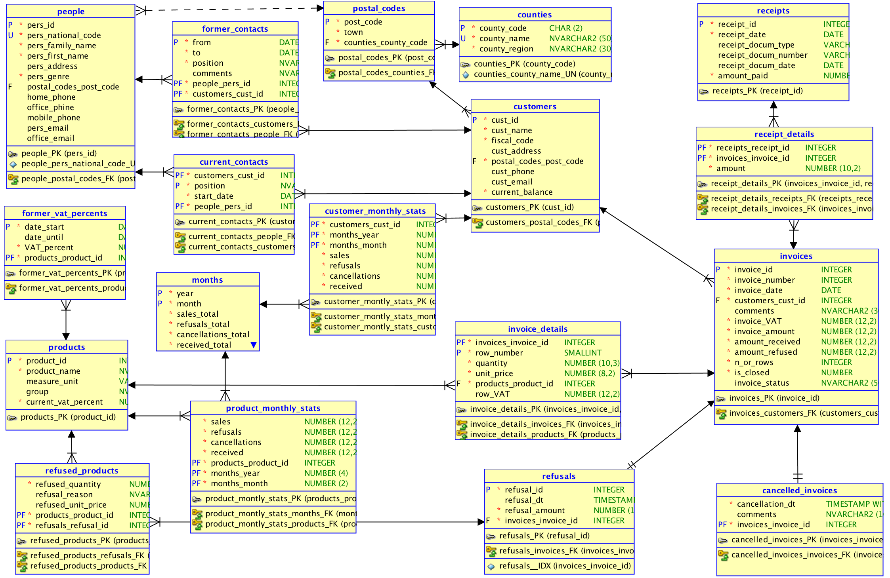
De/Post-Normalized Attributes in sales

Slide 3
Computed (by Triggers) Attributes in sales

Slide 4
Scripts on GitHub
See section 06_Triggers/ of the course:
https://github.com/marinfotache/Database-Logic-in-Business-Applications/tree/master/06_Triggers
Prerequisites (for setting up the database to this point)
06-00-2_fixed_DDL_script_sales_2015.sql
06-00-3_add_constraints_sales_2015.sql
06-01a_en_sequences.sql
06-01b_en_data_cleaning__surrogate_keys.sql
06-01c_en_cascade_updates.sql
Scripts related to this presentation:
06-02a_en_triggers_invoices.sql
06-02b_en_triggers__invoice_details.sql
06-02c_en_triggers__receipts__receipts_details.sql
06-02d_en_proc_auto_ins__receipts.sql
06-02e_en_triggers__refusals__refused_products.sql
06_02f_en_cancellations.sql

Slide 5
Script 06-02a_en_triggers_invoices.sql
Before following/executing the script...
Examine the denormalized attributes in table INVOICES
Identify other denormalized tables and attributes that must be updated/synchronized through table INVOICES’s triggers
Triggers for INSERT in table INVOICES
BEFORE ROW:
set the computed atributes (invoice_vat, invoice_amount, ...) on 0
AFTER ROW
check if exists a record in table MONTHS for current invoice’s month
check if exists a record in table CUSTOMER_MONTHLY_STATS for current invoice’s month and customer
first example of `mutating table` error
Triggers for UPDATE in table INVOICES
propagating table’s updates in all computed/denormalized tables/attributes that depend on it

